Slide 1
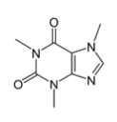
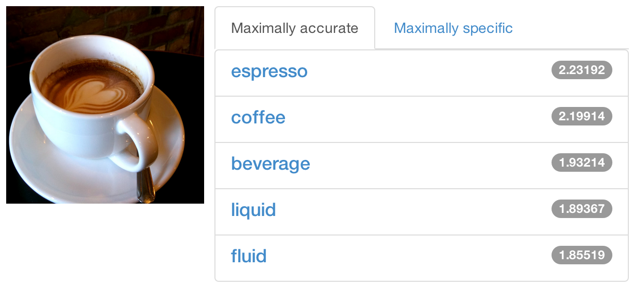


DIY Deep Learning for Vision:
a Hands-On Tutorial with Caffe
caffe.berkeleyvision.org
Evan Shelhamer, Jeff Donahue, Jon Long, Yangqing Jia, and Ross Girshick
github.com/BVLC/caffe
Look for further details in the outline notes
Notes:
see the latest and longer tutorial here: Caffe in a Day

Slide 2
Tutorial Schedule Caffe tour and latest roast
Caffe Tour
the why and how of Caffe
highlight reel of examples + applications
do-it-yourself notebooks
Latest Roast
detection Ross Girshick
sequences and vision + language Jeff Donahue
pixelwise prediction Jon Long and Evan Shelhamer
framework future Yangqing Jia

Slide 3
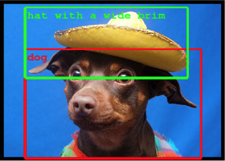
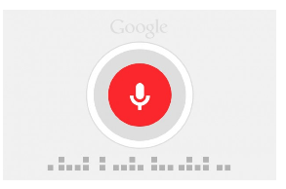
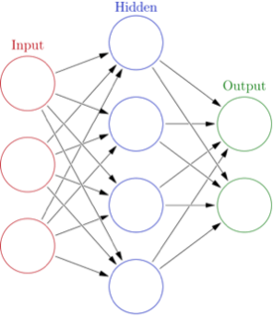
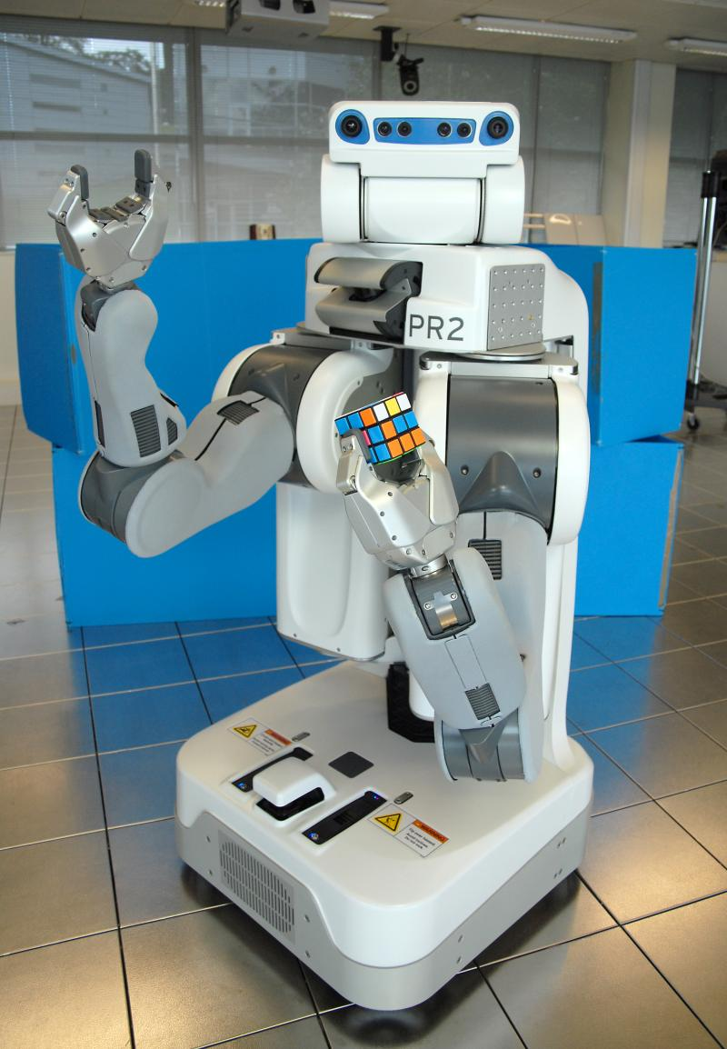
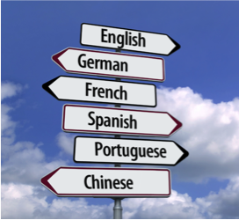
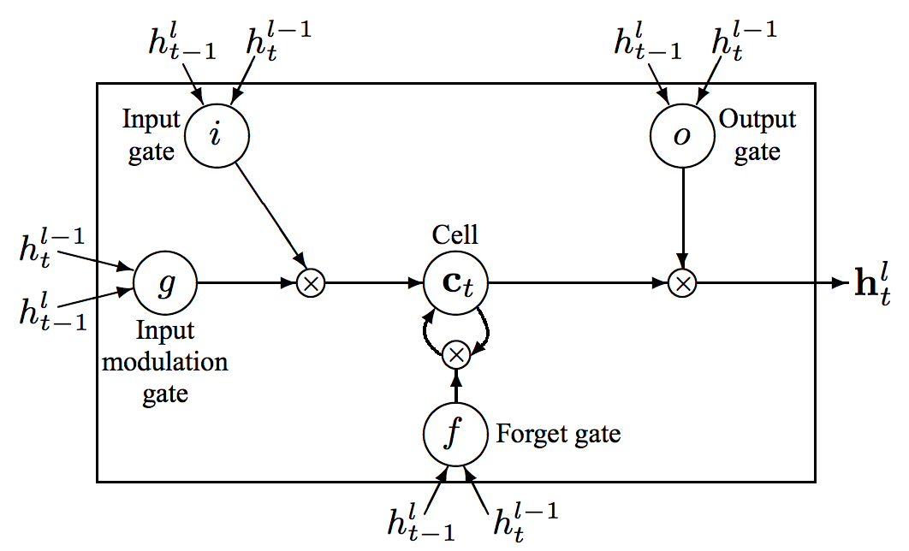
Why Deep Learning? End-to-End Learning for Many Tasks

Slide 4
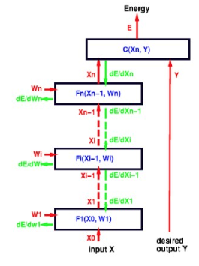
What is Deep Learning?
Compositional Models
Learned End-to-End
Hierarchy of Representations
vision: pixel, motif, part, object
text: character, word, clause, sentence
speech: audio, band, phone, word
concrete
abstract
learning
figure credit Yann LeCun, ICML ‘13 tutorial

Slide 5
What is Deep Learning?
Compositional Models
Learned End-to-End
Back-propagation jointly learns all of the model parameters to
optimize the output for the task.
figure credit Yann LeCun, ICML ‘13 tutorial

Slide 6
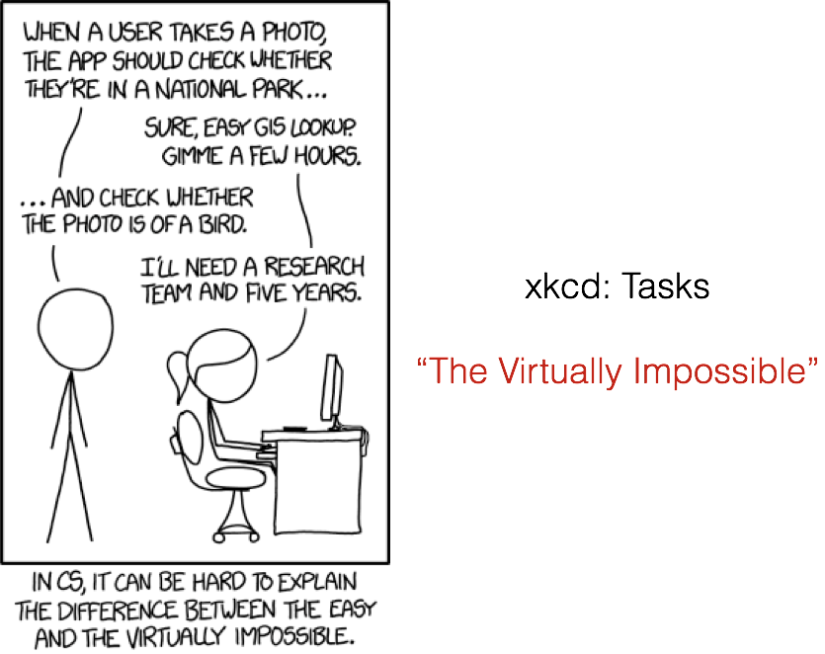

Slide 7
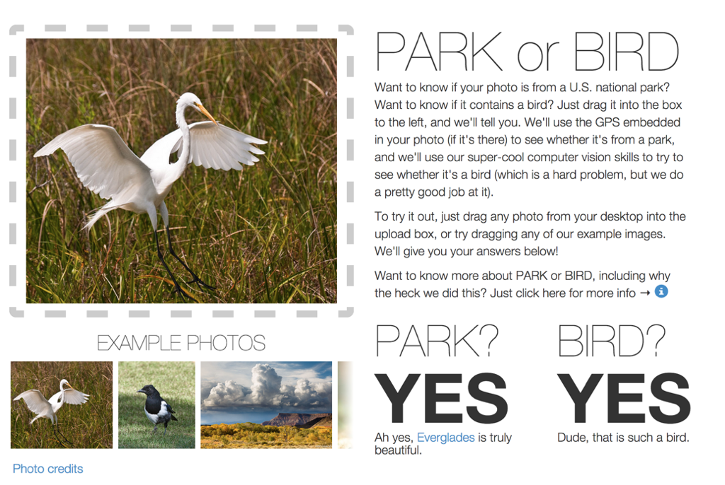

Slide 8

All in a day’s work with Caffe
http://code.flickr.net/2014/10/20/introducing-flickr-park-or-bird/

Slide 9

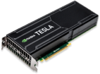
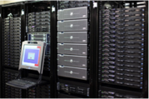
What is Caffe?
Open framework, models, and worked examples for deep learning
4.5 years old
7,000+ citations, 250+ contributors, 24,000+ stars
15,000+ forks, >1 pull request / day average at peak
focus has been vision, but also handles sequences, reinforcement learning, speech + text
Prototype
Train
Deploy

Slide 10
What is Caffe?
Open framework, models, and worked examples for deep learning
Pure C++ / CUDA library for deep learning
Command line, Python, MATLAB interfaces
Fast, well-tested code
Tools, reference models, demos, and recipes
Seamless switch between CPU and GPU
Prototype
Train
Deploy

Slide 11
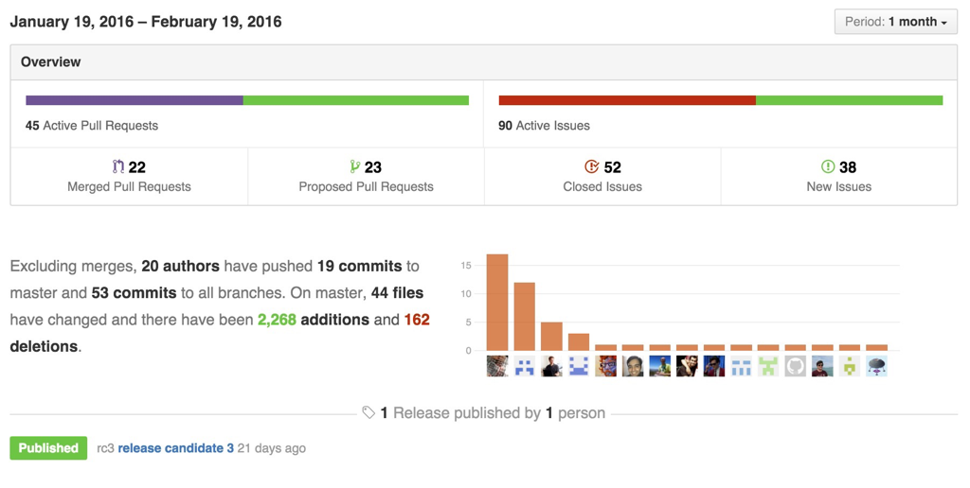
Caffe is a Community project pulse

Slide 12
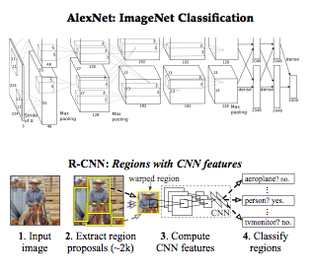
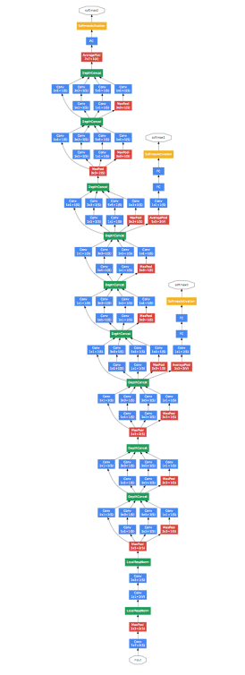
Reference Models
Caffe offers the
model definitions
optimization settings
pre-trained weights
so you can start right away.
The BVLC models are licensed for unrestricted use.
The community shares models in our Model Zoo.
GoogLeNet: ILSVRC14 winner

Slide 13
Open Model Collection
The Caffe Model Zoo open collection of deep models to share innovation
MSRA ResNet ILSVRC15 winner in the zoo
VGG ILSVRC14 + Devil models in the zoo
MIT Places scene recognition model in the zoo
Network-in-Network / CCCP model in the zoo
helps disseminate and reproduce research
bundled tools for loading and publishing models
Share Your Models! with your citation + license of course

Slide 14
Brewing by the Numbers...
Speed with Krizhevsky's 2012 model:
2 ms/image on K40 GPU
<1 ms inference with Caffe + cuDNN v4 on Titan X
72 million images/day with batched IO
8-core CPU: ~20 ms/image Intel optimization in progress
9k lines of C++ code (20k with tests)

Slide 15
CAFFE
EXAMPLES + APPLICATIONS

Slide 16
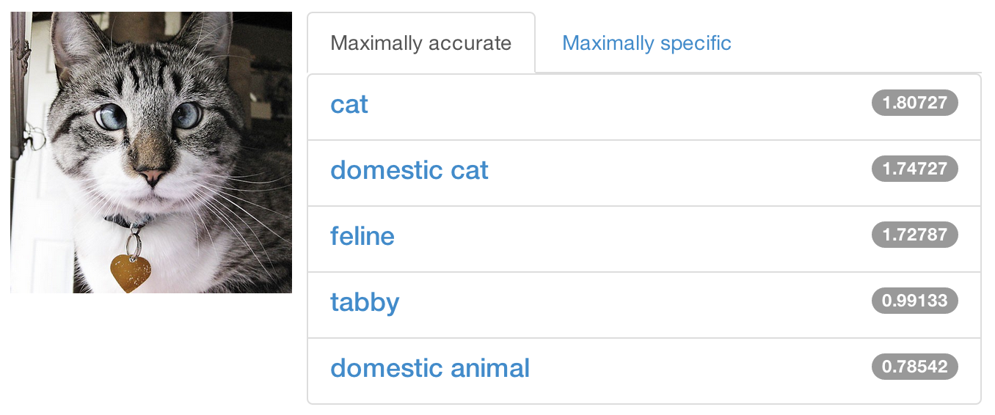
Share a Sip of Brewed Models
demo.caffe.berkeleyvision.org
demo code open-source and bundled

Slide 17
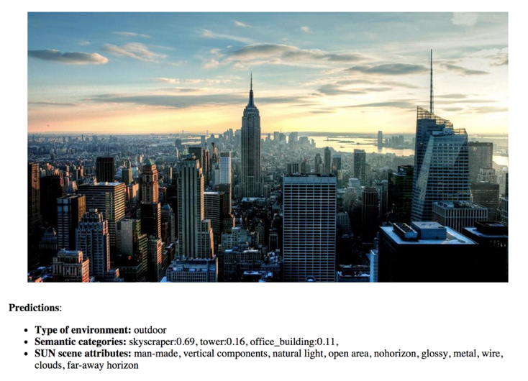
Scene Recognition http://places.csail.mit.edu/
B. Zhou et al. NIPS 14

Slide 18
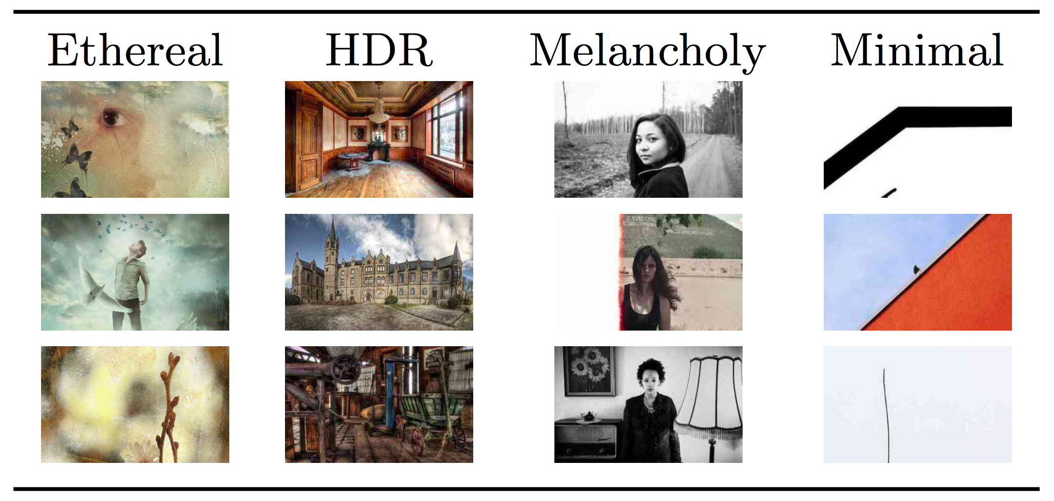
Visual Style Recognition
Karayev et al. Recognizing Image Style. BMVC14. Caffe fine-tuning example.
Demo online at http://demo.vislab.berkeleyvision.org/ (see Results Explorer).
Other Styles:
Vintage
Long Exposure
Noir
Pastel
Macro
… and so on.
[ Image-Style]

Slide 19
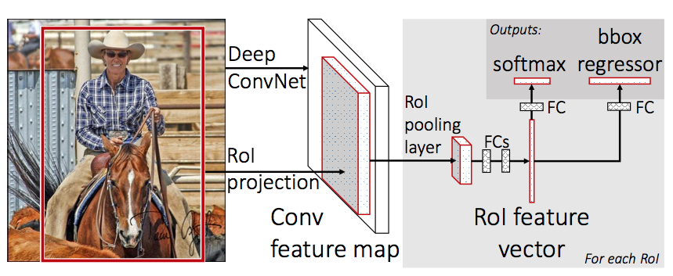
Object Detection
R-CNNs: Region-based Convolutional Networks
Fast R-CNN
convolve once
project + detect
Faster R-CNN
end-to-end proposals and detection
image inference in 200 ms
Region Proposal Net + Fast R-CNN
papers + code online
Ross Girshick, Shaoqing Ren, Kaiming He, Jian Sun

Slide 20
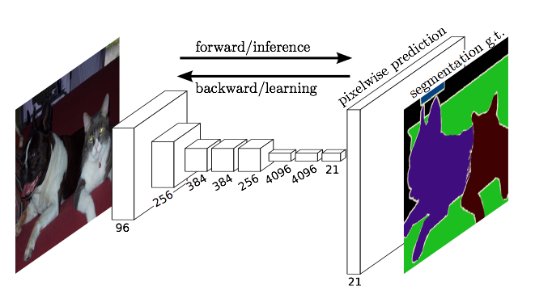
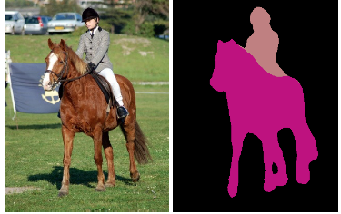
Pixelwise Prediction
Fully convolutional networks for pixel prediction in particular semantic segmentation
end-to-end learning
efficient inference and learning 100 ms per-image prediction
multi-modal, multi-task
Applications
semantic segmentation
denoising
depth estimation
optical flow
Jon Long* & Evan Shelhamer*,
Trevor Darrell. CVPR’15
CVPR'15 paper and code + models
Notes:
100 ms inference on Titan X for 500x500 image, 21 classes with large, accurate network (derived from VGG)

Slide 21
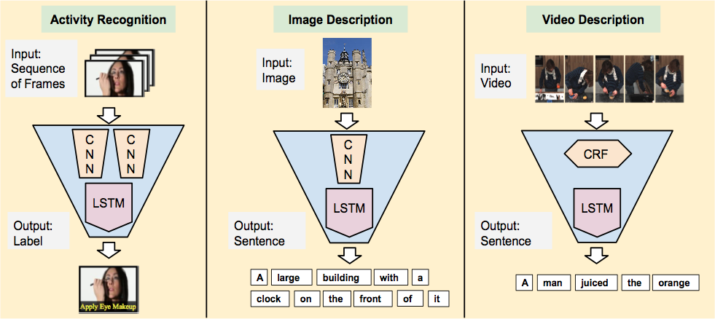
Visual Sequence Tasks
Jeff Donahue et al. CVPR’15

Slide 22
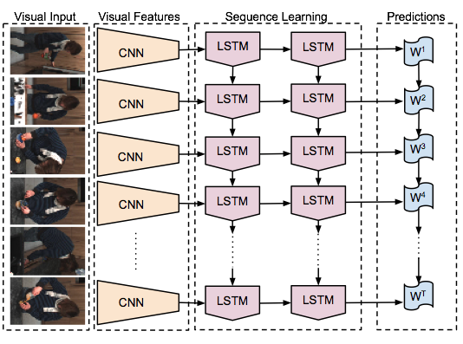
Recurrent Networks for Sequences
Recurrent Nets and Long Short Term Memories (LSTM) are sequential models
video
language
dynamics
learned by backpropagation through time
LRCN: Long-term Recurrent Convolutional Network
activity recognition (sequence-in)
image captioning (sequence-out)
video captioning (sequence-to-sequence)
LRCN:
recurrent + convolutional for visual sequences
CVPR'15 paper and code + models

Slide 23
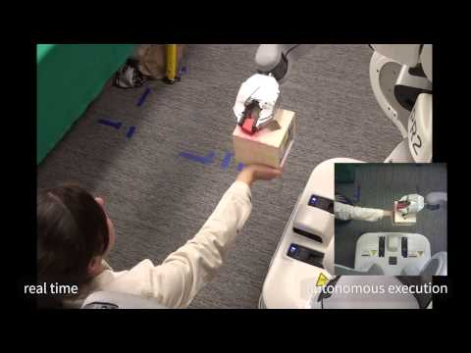
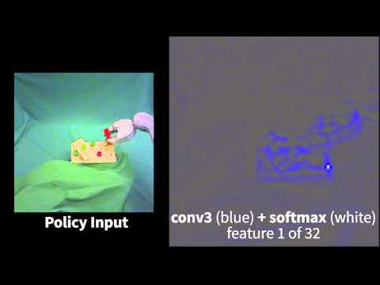
Deep Visuomotor Control
example experiments
feature visualization
Sergey Levine* & Chelsea Finn*, Trevor Darrell, and Pieter Abbeel

Slide 24
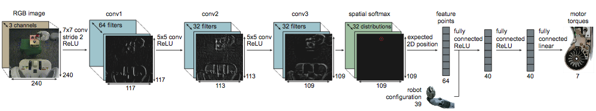
Deep Visuomotor Control Architecture
multimodal (images & robot configuration)
runs at 20 Hz - mixed GPU & CPU for real-time control
paper + code for guided policy search
Sergey Levine* & Chelsea Finn*, Trevor Darrell, and Pieter Abbeel

Slide 25

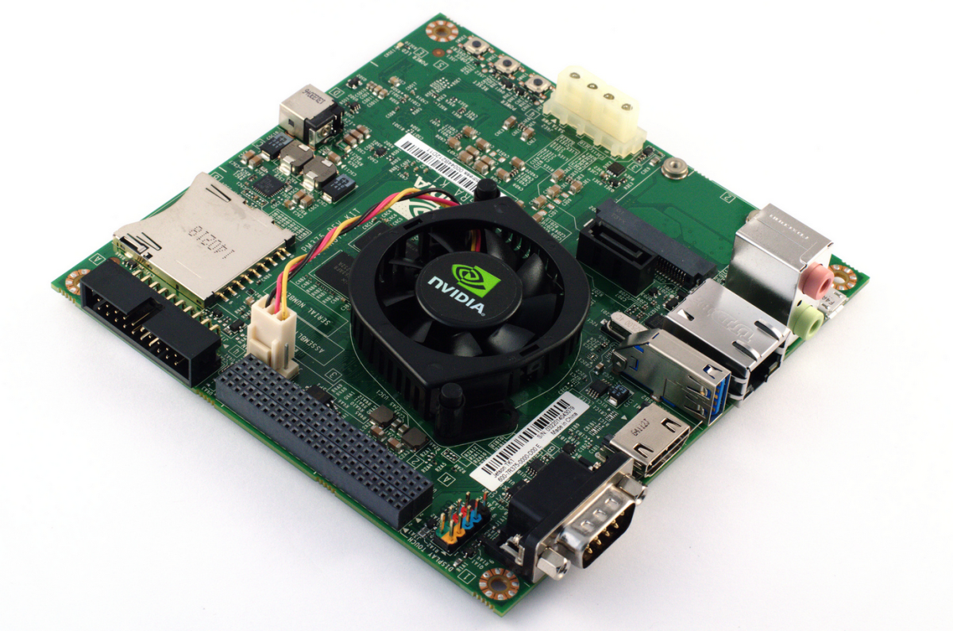

Embedded Caffe
Caffe runs on embedded CUDA hardware and mobile devices
same model weights, same framework interface
out-of-the-box on CUDA platforms
in-progress OpenCL port thanks Fabian Tschopp! + AMD, Intel, and the community
community Android port thanks sh1r0!
OpenCL branch
CUDA Jetson TX1, TK1
Android lib, demo

Slide 26












Caffeinated Companies
… startups, big companies, more ...

Slide 27
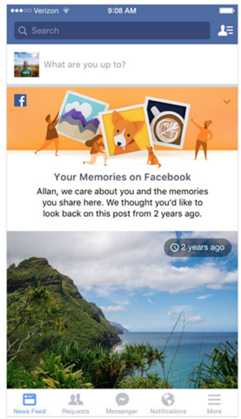
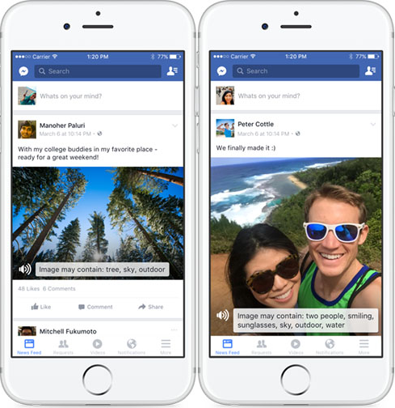
Caffe at Facebook
in production for vision at scale: uploaded photos run through Caffe
Automatic Alt Text for the blind
On This Day for surfacing memories
objectionable content detection
contributing back to the community: inference tuning, tools, code review include fb-caffe-exts thanks Andrew!
On This Day
highlight content
Automatic Alt Text
recognize photo content for accessibility
[example credit Facebook]

Slide 28
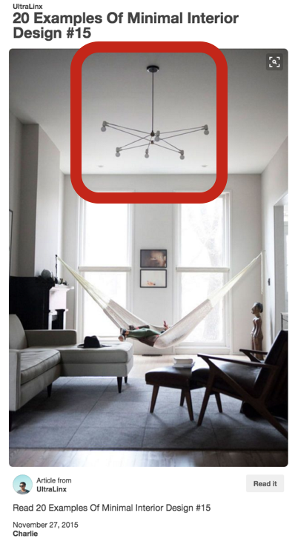
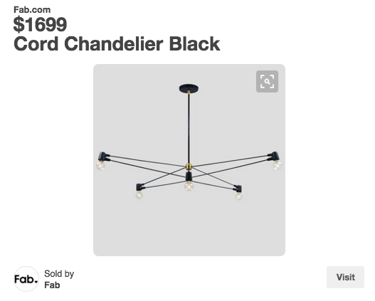

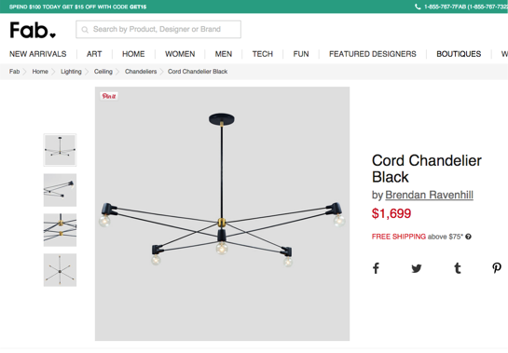
Caffe at Pinterest
in production for vision at scale: uploaded photos run through Caffe
deep learning for visual search: retrieval over billions of images in <250 ms
~4 million requests/day
built on an open platform of Caffe, FLANN, Thrift, ...
[example credit Andrew Zhai, Pinterest]

Slide 29
Caffe at Adobe
training networks for research in vision and graphics
custom inference in products, including Photoshop
Photoshop Type Similarity
catalogue typefaces automatically

Slide 30
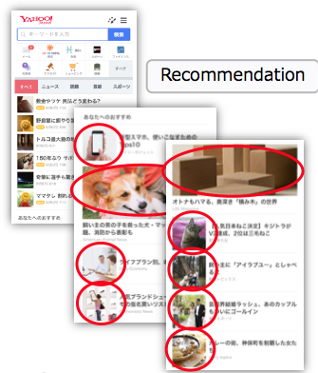
Caffe at Yahoo! Japan
curate news and restaurant photos for recommendation
arrange user photo albums
News Image Recommendation
select and crop images for news

Slide 31
Classification
instant recognition the Caffe way
see notebook

Slide 32
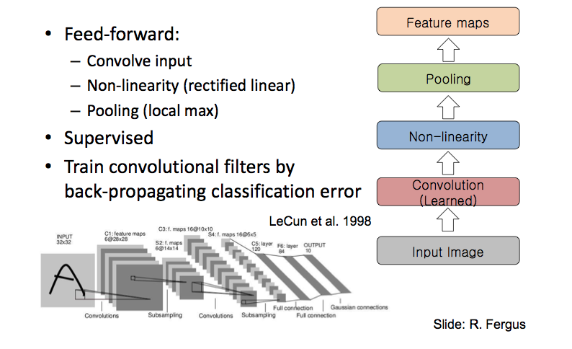
Convolutional Network

Slide 33
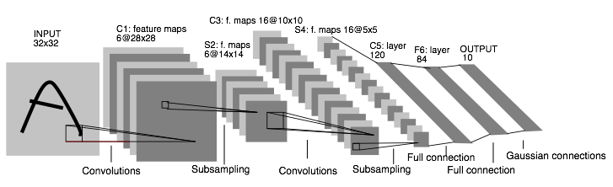
Convolutional Networks: 1989
LeNet: a layered model composed of convolution and subsampling operations followed by a holistic representation and ultimately a classifier for handwritten digits. [ LeNet ]

Slide 34
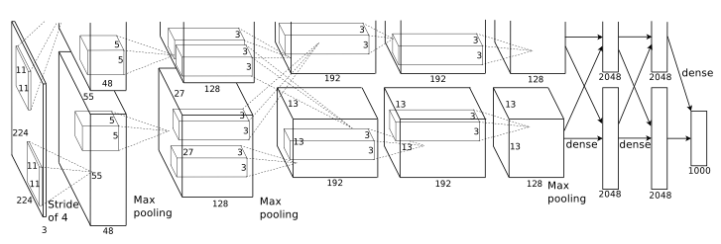
Convolutional Nets: 2012
AlexNet: a layered model composed of convolution, subsampling, and further operations followed by a holistic representation and all-in-all a landmark classifier on
ILSVRC12. [ AlexNet ]
+ data
+ gpu
+ non-saturating nonlinearity
+ regularization

Slide 35
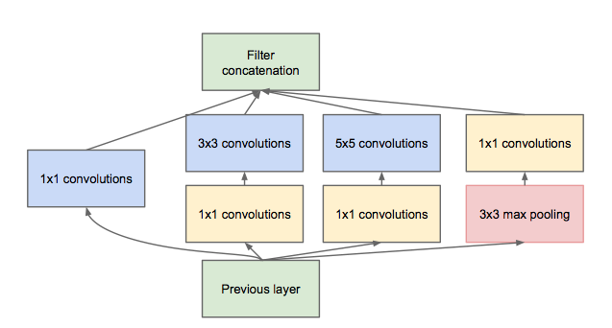
Convolutional Nets: 2014
ILSVRC14 Winners: ~6.6% Top-5 error
GoogLeNet: composition of multi-scale dimension-reduced modules (pictured)
VGG: 16 layers of 3x3 convolution interleaved with max pooling + 3 fully-connected layers
+ depth
+ data
+ dimensionality reduction

Slide 36
Learning LeNet
back to the future of visual recognition
see notebook

Slide 37
Deep Learning, as it is executed...
What should a framework handle?
Compositional Models
Decompose the problem and code!
End-to-End Learning
Configure and solve!
Many Architectures and Tasks
Define, experiment, and extend!

Slide 38
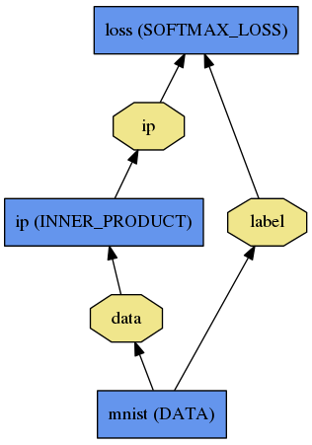
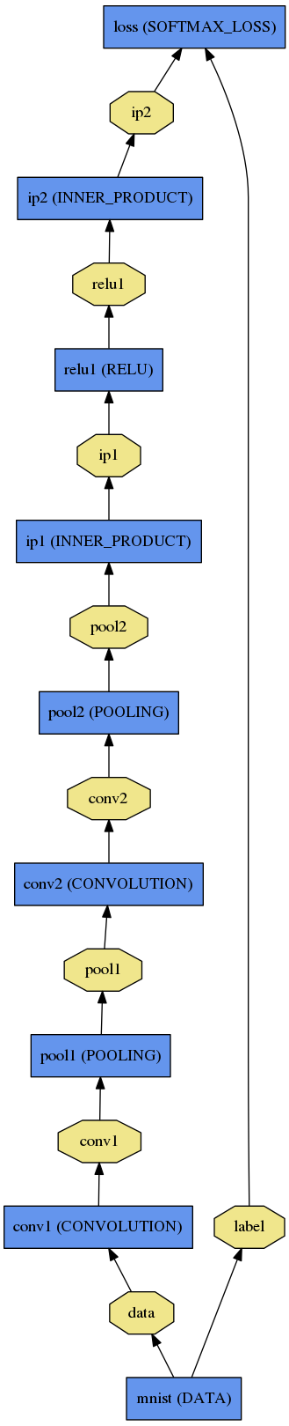
Net
A network is a set of layers and their connections:
name: "dummy-net"
layer { name: "data" …}
layer { name: "conv" …}
layer { name: "pool" …}
… more layers …
layer { name: "loss" …}
LogReg ↑
Caffe creates and checks the net from the definition.
Data and derivatives flow through the net as blobs – an array interface
LeNet →
ImageNet, Krizhevsky 2012 →

Slide 39
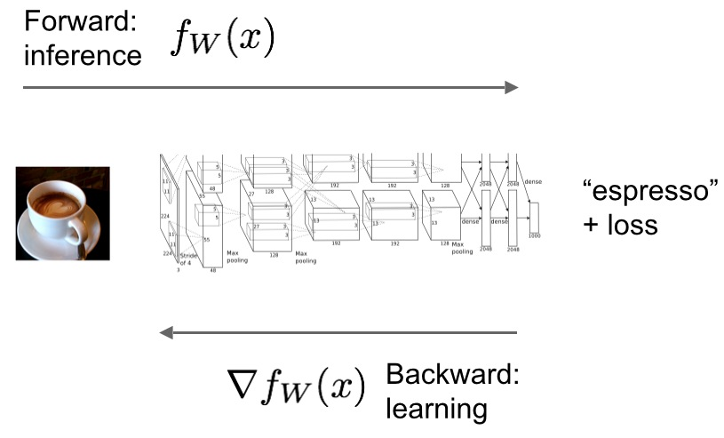
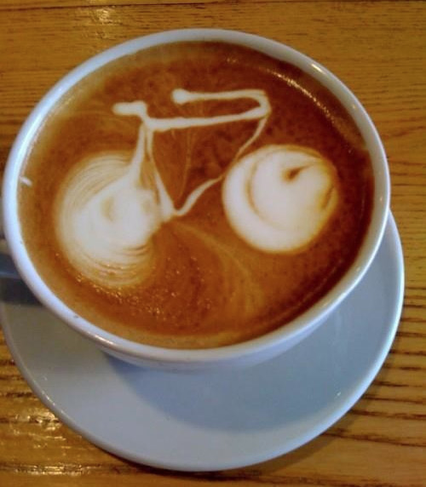
Forward / Backward the essential Net computations
Caffe models are complete machine learning systems for inference and learning.
The computation follows from the model definition. Define the model and run.

Slide 40
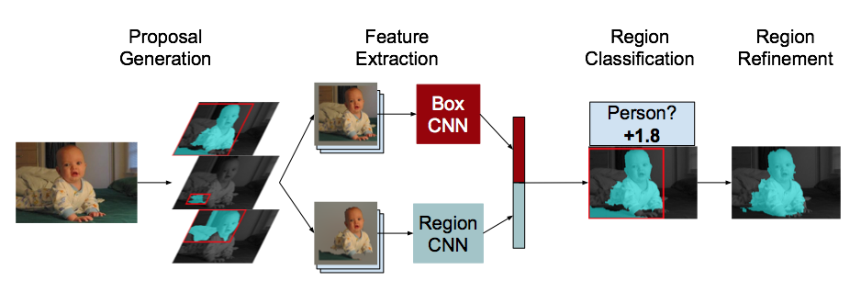
DAG
SDS two-stream net
Many current deep models
have linear structure
GoogLeNet Inception Module
but Caffe nets can have any directed acyclic graph (DAG) structure.
Define bottoms and tops and Caffe will connect the net.
LRCN joint vision-sequence model

Slide 41
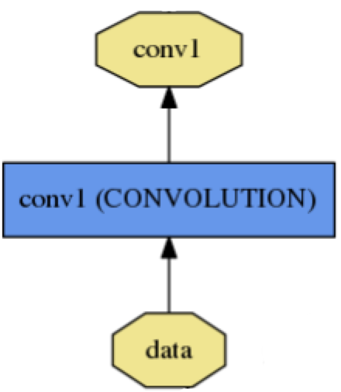
Layer Protocol
Setup: run once for initialization.
Forward: make output given input.
Backward: make gradient of output
- w.r.t. bottom
- w.r.t. parameters (if needed)
Reshape: set dimensions.
Compositional Modeling The Net’s forward and backward passes are composed of the layers’ steps.
Layer Development Checklist

Slide 42
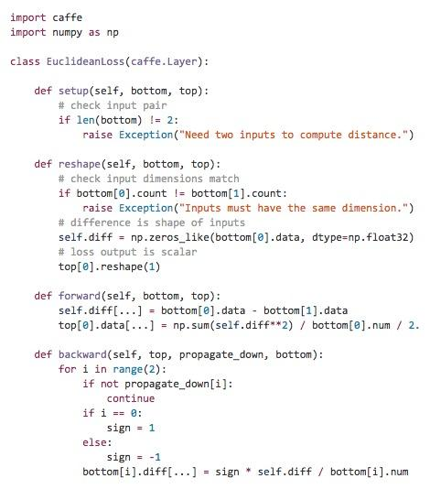
Layer Protocol
== Class Interface
Define a class in C++ or Python to extend Layer.
Include your new layer type in a network and keep brewing.
layer {
type: "Python" python_param {
module: "layers"
layer: "EuclideanLoss"
} }

Slide 43
Blob
name: "conv1"
type: CONVOLUTION
bottom: "data"
top: "conv1"
… definition …
Blobs are N-D arrays for storing and communicating information.
hold data, derivatives, and parameters
lazily allocate memory
shuttle between CPU and GPU
top blob
Data
Number x K Channel x Height x Width
256 x 3 x 227 x 227 for ImageNet train input
Parameter: Convolution Weight
N Output x K Input x Height x Width
96 x 3 x 11 x 11 for CaffeNet conv1
Parameter: Convolution Bias
96 x 1 x 1 x 1 for CaffeNet conv1
bottom blob

Slide 44
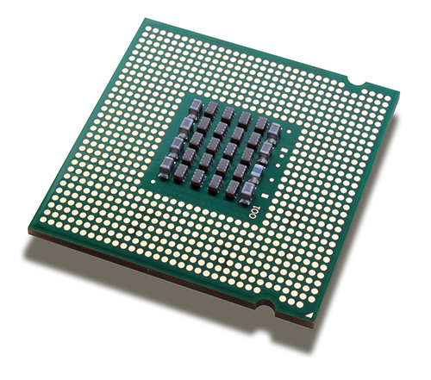
Blob
Blobs provide a unified memory interface.
Reshape(num, channel, height, width)
- declare dimensions
- make SyncedMem -- but only lazily allocate
cpu_data(), mutable_cpu_data()
- host memory for CPU mode
gpu_data(), mutable_gpu_data()
- device memory for GPU mode
SyncedMem
allocation + communication
{cpu,gpu}_diff(), mutable_{cpu,gpu}_diff()
- derivative counterparts to data methods
- easy access to data + diff in forward / backward

Slide 45
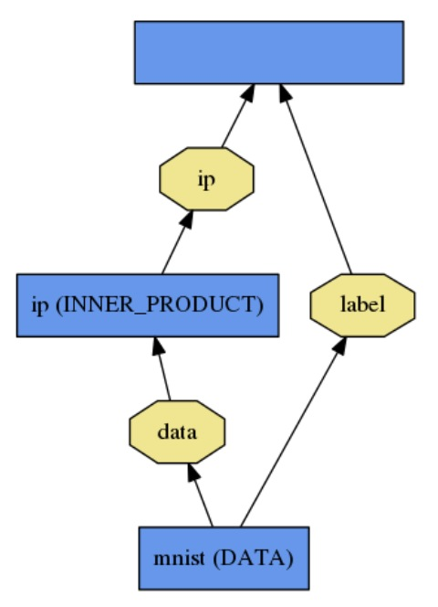
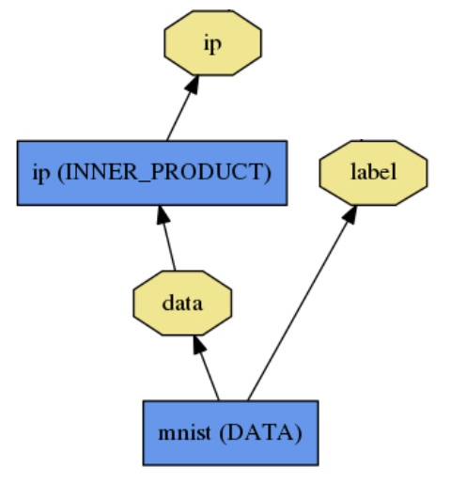
Loss
loss (LOSS_TYPE)
Classification
SoftmaxWithLoss
HingeLoss
Linear Regression
EuclideanLoss
Attributes / Multiclassification
SigmoidCrossEntropyLoss
Others…
New Task
NewLoss
What kind of model is this?
Define the task by the loss.

Slide 46
Protobuf Model Format
Strongly typed format
Auto-generates code
Developed by Google
Defines Net / Layer / Solver schemas in caffe.proto
name: "conv1"
type: "Convolution"
bottom: "data"
top: "conv1"
convolution_param {
num_output: 20
kernel_size: 5
stride: 1
weight_filler {
type: "xavier"
}
}
message ConvolutionParameter {
// The number of outputs for the layer
optional uint32 num_output = 1;
// whether to have bias terms
optional bool bias_term = 2 [default = true];
}

Slide 47
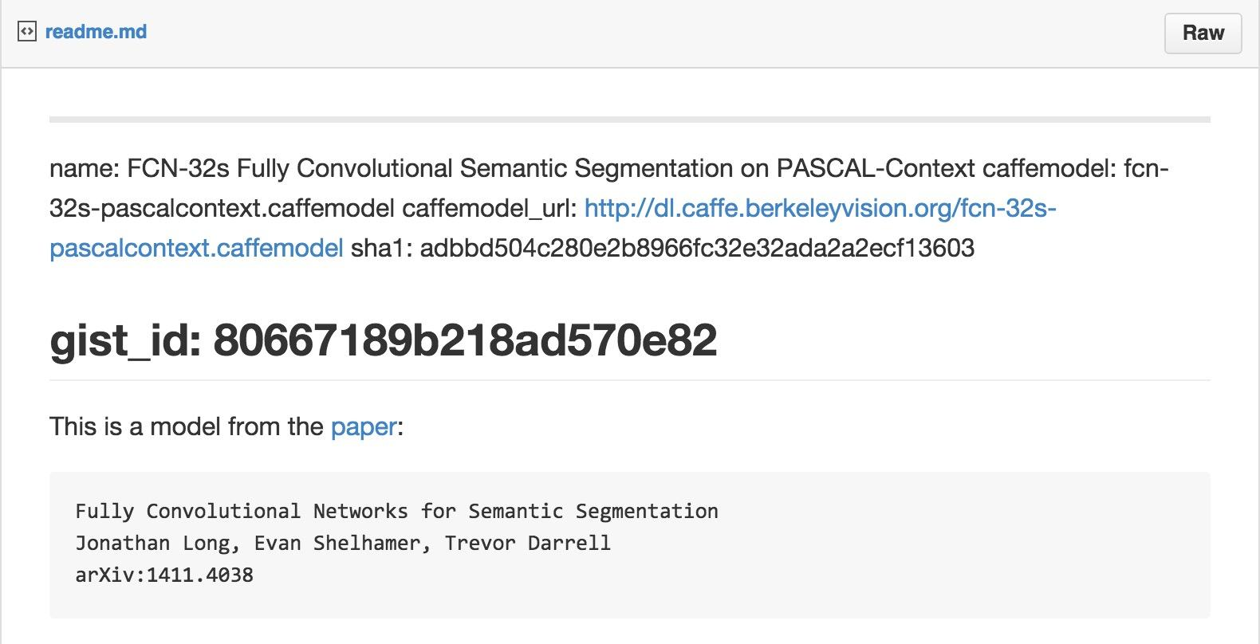
Model Zoo Format
Gists on github hold model definition, license, url for weights, and hash of Caffe commit that guarantees compatibility.

Slide 48
Solving: Training a Net
Optimization like model definition is configuration.
train_net: "lenet_train.prototxt"
base_lr: 0.01
momentum: 0.9
weight_decay: 0.0005
max_iter: 10000
snapshot_prefix: "lenet_snapshot"
All you need to run things on the GPU.
> caffe train -solver lenet_solver.prototxt -gpu 0
Stochastic Gradient Descent (SGD) + momentum ·
Adaptive Gradient (ADAGRAD) · Nesterov’s Accelerated Gradient (NAG)

Slide 49
Solver Showdown: MNIST Autoencoder
AdaGrad
SGD
Nesterov
I0901 13:36:30.007884 24952 solver.cpp:232] Iteration 65000, loss = 64.1627 I0901 13:36:30.007922 24952 solver.cpp:251] Iteration 65000, Testing net (#0) # train set I0901 13:36:33.019305 24952 solver.cpp:289] Test loss: 63.217 I0901 13:36:33.019356 24952 solver.cpp:302] Test net output #0: cross_entropy_loss = 63.217 (* 1 = 63.217 loss) I0901 13:36:33.019773 24952 solver.cpp:302] Test net output #1: l2_error = 2.40951
I0901 13:35:20.426187 20072 solver.cpp:232] Iteration 65000, loss = 61.5498 I0901 13:35:20.426218 20072 solver.cpp:251] Iteration 65000, Testing net (#0) # train set I0901 13:35:22.780092 20072 solver.cpp:289] Test loss: 60.8301 I0901 13:35:22.780138 20072 solver.cpp:302] Test net output #0: cross_entropy_loss = 60.8301 (* 1 = 60.8301 loss) I0901 13:35:22.780146 20072 solver.cpp:302] Test net output #1: l2_error = 2.02321
I0901 13:36:52.466069 22488 solver.cpp:232] Iteration 65000, loss = 59.9389 I0901 13:36:52.466099 22488 solver.cpp:251] Iteration 65000, Testing net (#0) # train set I0901 13:36:55.068370 22488 solver.cpp:289] Test loss: 59.3663 I0901 13:36:55.068410 22488 solver.cpp:302] Test net output #0: cross_entropy_loss = 59.3663 (* 1 = 59.3663 loss) I0901 13:36:55.068418 22488 solver.cpp:302] Test net output #1: l2_error = 1.79998

Slide 50
Weight Sharing
Just give the parameter blobs explicit names using the param field
Layers specifying the same param name will share that parameter, accumulating gradients accordingly
layer: {
name: 'innerproduct1'
type: INNER_PRODUCT
inner_product_param {
num_output: 10
bias_term: false
weight_filler {
type: 'gaussian'
std: 10
}
}
param: 'sharedweights'
bottom: 'data'
top: 'innerproduct1'
}
layer: {
name: 'innerproduct2'
type: INNER_PRODUCT
inner_product_param {
num_output: 10
bias_term: false
}
param: 'sharedweights'
bottom: 'data'
top: 'innerproduct2'
}

Slide 51
Recipe for Brewing
Convert the data to Caffe-format
lmdb, leveldb, hdf5 / .mat, list of images, etc.
Define the Net
Configure the Solver
caffe train -solver solver.prototxt -gpu 0
Examples are your friends
caffe/examples/mnist,cifar10,imagenet
caffe/examples/*.ipynb
caffe/models/*

Slide 52
Brewing Models
from logistic regression to non-linearity see notebook

Slide 53
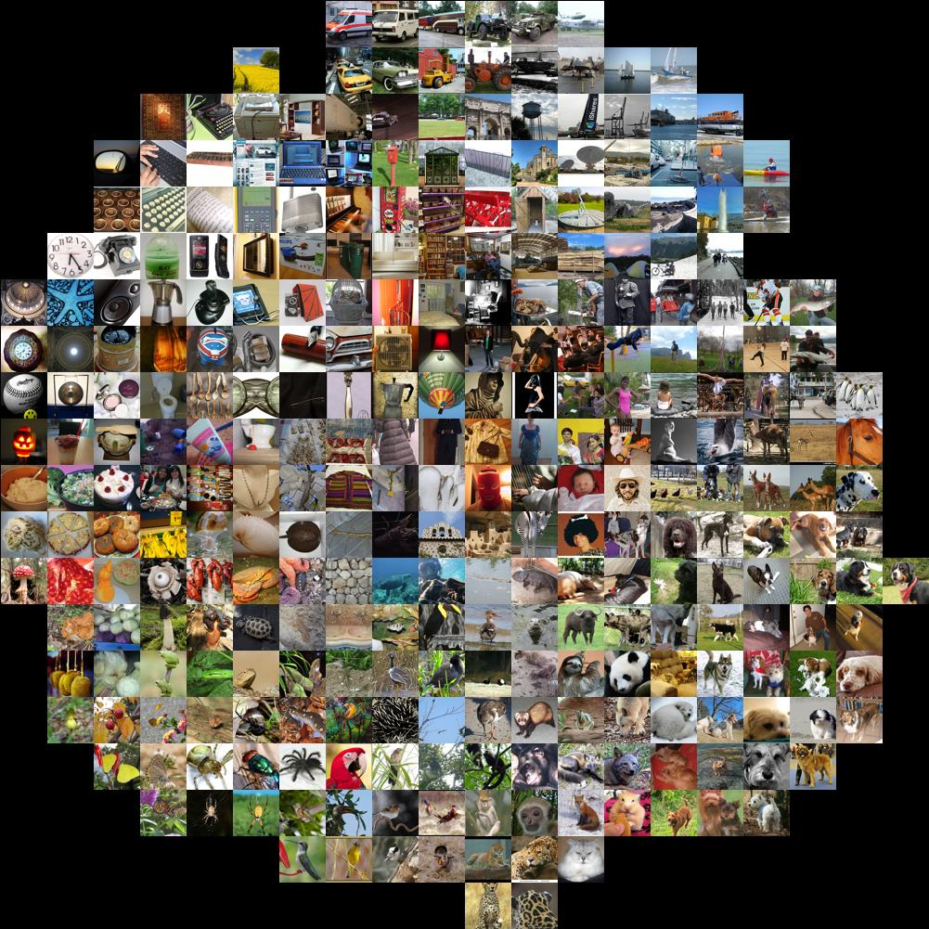


Take a pre-trained model and fine-tune to new tasks [DeCAF] [Zeiler-Fergus] [OverFeat]
Lots of Data
Style
Recognition
ImageNet
Dogs vs.
Cats
top 10 in 10 minutes
image by Andrej Karpathy
Your Task
© kaggle.com

Slide 54
From ImageNet to Style
Simply change a few lines in the model definition
layer { name: "data" type: "Data"
data_param {
source: "ilsvrc12_train_lmdb"
mean_file: "../../data/ilsvrc12"
...
}
...
}
...
layer { name: "fc8" type: "InnerProduct"
inner_product_param {
num_output: 1000
...
}
}
layer { name: "data" type: "Data"
data_param {
source: "style_train_lmdb"
mean_file: "../../data/ilsvrc12"
...
}
...
}
...
layer { name: "fc8-style" type: "InnerProduct"
inner_product_param {
num_output: 20
...
}
}
Input:
A different source
new name = new params
Last Layer:
A different classifier

Slide 55

From ImageNet to Style
> caffe train -solver models/finetune_flickr_style/solver.prototxt
-weights bvlc_reference_caffenet.caffemodel
Step-by-step in pycaffe:
pretrained_net = caffe.Net(
"net.prototxt", "net.caffemodel")
solver = caffe.SGDSolver("solver.prototxt")
solver.net.copy_from(pretrained_net)
solver.solve()

Slide 56
Fine-tuning
transferring features to style recognition
see notebook

Slide 57

When to Fine-tune?
A good first step
More robust optimization – good initialization helps
Needs less data
Faster learning
State-of-the-art results in
recognition
detection
segmentation
[Zeiler-Fergus]

Slide 58
Fine-tuning Tricks
Learn the last layer first
Caffe layers have local learning rates: param { lr_mult: 1 }
Freeze all but the last layer for fast optimization and avoiding early divergence by setting lr_mult: 0 to fix a parameter.
Stop if good enough, or keep fine-tuning
Reduce the learning rate
Drop the solver learning rate by 10x, 100x
Preserve the initialization from pre-training and avoid divergence
Do net surgery see notebook on editing model parameters

Slide 59

Transferability of Features
Yosinski et al. NIPS 2014

Slide 60




After fine-tuning
Supervised pre-training does not overfit
Representation is (mostly) distributed
Sparsity comes “for free” in deep representation
P. Agarwal et al. ECCV 14

Slide 61
Editing model parameters
how to do net surgery to set custom weights
see notebook

Slide 62



Up Next The Latest Roast
Detection
Pixelwise Prediction
Sequences
Framework Future

Slide 63
Detection
Fast R-CNN
convolve once
project + detect
Faster R-CNN
end-to-end proposals and detection
200 ms / image inference
fully convolutional Region Proposal Net + Fast R-CNN
arXiv and code for Fast R-CNN
Ross Girshick, Shaoqing Ren, Kaiming He, Jian Sun
Notes:
TODO

Slide 64
Pixelwise Prediction
Fully convolutional networks for pixel prediction
applied to semantic segmentation
end-to-end learning
efficient inference and learning 150 ms per-image prediction
multi-modal, multi-task
Further applications
depth
boundaries
flow + more
CVPR15 arXiv and reference models + code
Jon Long* & Evan Shelhamer*,
Trevor Darrell

Slide 65

Sequences
Recurrent Net and Long Short Term Memory LSTM are sequential models
video
language
dynamics
learned by backpropagation through time.
LRCN: Long-term Recurrent Convolutional Network
activity recognition
image captioning
video captioning
CVPR15 arXiv and project site
Jeff Donahue et al.

Slide 66
Framework Future
1.0 is coming stability, documentation, packaging
Performance Tuning for GPU (cuDNN v5) and CPU (nnpack)
In-progress Ports for OpenCL and Windows
Halide interface for prototyping and experimenting
Widening the Circle continued and closer collaborative development

Slide 67

Next Steps
Now you’ve seen the progress made with DIY deep learning and the democratization of models
Next Up:
caffe.berkeleyvision.org
github.com/BVLC/caffe
Run Caffe through Docker and NVIDIA Docker for GPU
Join the caffe-users mailing list
Check out Caffe on github

Slide 68
Help Brewing
Documentation
tutorial documentation
hands-on examples
Modeling, Usage, and Installation
caffe-users group
gitter.im chat
Convolutional Nets
CS231n online convnet class by Andrej Karpathy and Fei-Fei Li
Deep Learning Online by Michael Nielsen
Deep Learning Book by Goodfellow, Bengio, Courville

Slide 69









Thanks to the Caffe Crew
...plus the cold-brew
Yangqing Jia, Evan Shelhamer, Jeff Donahue, Jonathan Long, Sergey Karayev, Ross Girshick, Sergio Guadarrama, Ronghang Hu, Trevor Darrell
and our open source contributors!

Slide 70
Acknowledgements
Thank you to the Berkeley Vision and Learning Center and its Sponsors
Thank you to NVIDIA
for GPUs, cuDNN collaboration, and hands-on cloud instances
Thank you to our 150+
open source contributors
and vibrant community!
Thank you to A9 and AWS
for a research grant for Caffe dev and reproducible research

Slide 71
References
[ DeCAF ] J. Donahue, Y. Jia, O. Vinyals, J. Hoffman, N. Zhang, E. Tzeng, and T. Darrell. Decaf: A deep convolutional activation feature for generic visual recognition. ICML, 2014.
[ R-CNN ] R. Girshick, J. Donahue, T. Darrell, and J. Malik. Rich feature hierarchies for accurate object detection and semantic segmentation. CVPR, 2014.
[ Zeiler-Fergus ] M. Zeiler and R. Fergus. Visualizing and understanding convolutional networks. ECCV, 2014.
[ LeNet ] Y. LeCun, L. Bottou, Y. Bengio, and P. Haffner. Gradient-based learning applied to document recognition. IEEE, 1998.
[ AlexNet ] A. Krizhevsky, I. Sutskever, and G. Hinton. Imagenet classification with deep convolutional neural networks. NIPS, 2012.
[ OverFeat ] P. Sermanet, D. Eigen, X. Zhang, M. Mathieu, R. Fergus, and Y. LeCun. Overfeat: Integrated recognition, localization and detection using convolutional networks. ICLR, 2014.
[ Image-Style ] S. Karayev, M. Trentacoste, H. Han, A. Agarwala, T. Darrell, A. Hertzmann, H. Winnemoeller. Recognizing Image Style. BMVC, 2014.
[ Karpathy14 ] A. Karpathy, G. Toderici, S. Shetty, T. Leung, R. Sukthankar, and L. Fei-Fei. Large-scale video classification with convolutional neural networks. CVPR, 2014.
[ Sutskever13 ] I. Sutskever. Training Recurrent Neural Networks. PhD thesis, University of Toronto, 2013.
[ Chopra05 ] S. Chopra, R. Hadsell, and Y. LeCun. Learning a similarity metric discriminatively, with application to face verification. CVPR, 2005.

Slide 72
END

Slide 73
MORE DETAILS

Slide 74

Why Deep Learning? The Unreasonable Effectiveness of Deep Features
Classes separate in the deep representations and transfer to many tasks. [DeCAF] [Zeiler-Fergus]

Slide 75


Why Deep Learning? The Unreasonable Effectiveness of Deep Features
Maximal activations of pool₅ units
[R-CNN]
conv₅ DeConv visualization
Rich visual structure of features deep in hierarchy.
[Zeiler-Fergus]

Slide 76


Why Deep Learning? The Unreasonable Effectiveness of Deep Features
1st layer filters
image patches that strongly activate 1st layer filters
[Zeiler-Fergus]

